Slide 1
Summary
MutaCraft Update (Benchmark vs BindCraft)
Custom Phage Library (7-12 binder length) suggestions

Slide 2
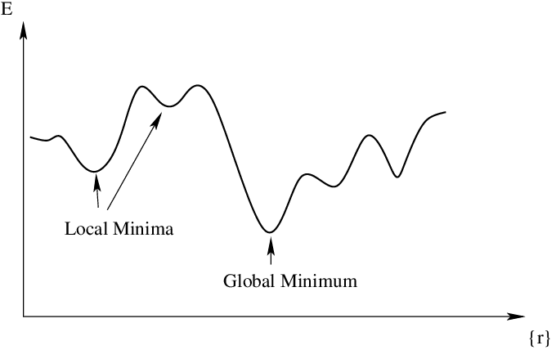
MutaCraft Rationale
De novo binder generation can be costly as it generates random binders, may drift away from designs that can actually exist in the real world, wasting compute.
Pure Mutational binder generation may not explore global minimum
Hybrid approach to get the best of both worlds:
  Preserve trusted residues to save computation, while keeping random exploration to find global min

Slide 3
MutaCraft Procedure
Doesn’t make use of BindCraft code/scripts, uses a new procedure:
User inputs Target Protein and Template Binder
MutaCraft masks subset of residues in Template Binder to preserve them
Perform 4-stage AlphaFold2 optimisation passes (edited from BindCraft)
Evaluate and keep best binders
Template Binder as Seed: Keep these residues
Change the rest

Slide 4
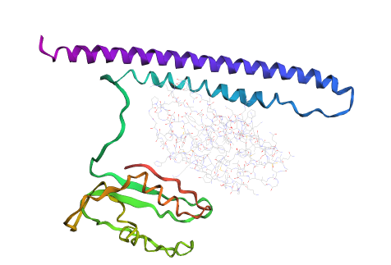
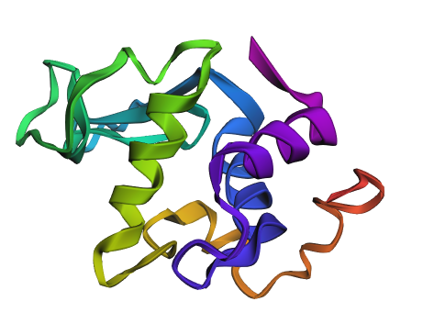
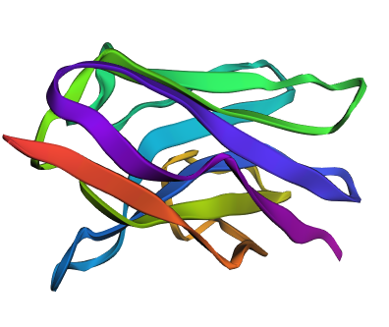
Test Run: Human Lysozyme Binder
1OP9.pdb: Complex of human lysozyme with camelid VHH HL6 antibody fragment
Target protein: Human lysozyme
  Chosen as it’s a small, and well-studied, stable protein
Binder template: HL6
I tested MutaCraft by letting it generate binders using HL6 as the seed, then evaluated them
Target: Lysozyme
Binder Template: HL6
My MutaCraft generated Binder

Slide 5
Results (vs template binder)
Binder | plddt_mean Higher is better | ptm_mean Higher is better | i_ptm_mean Higher is better | pae_mean Lower is better | i_pae_mean Lower is better | loss_mean Lower is better
HL6 camel VHH template (Original Binder) | 0.397544 | 0.439117 | 0.154836 | 0.766483 | 0.881567 | 6.450178
Best MutaCraft Binder | 0.494419 | 0.44309 | 0.155191 | 0.761355 | 0.853633 | 5.961434
Improvement Percentage | 24.3%☑ | 0.9%☑ | 0.22%☑ | 0.669%☑ | 3.2%☑ | 7.6%☑
I re-predicted the binder & complex w/ AF2, then scored w/ AF2 & Rosetta:
MutaCraft’s binder shows Improvement across all metrics:
pLDDT (predicted Local Distance Difference Test): Binder residue-level confidence
pTM (predicted TM-score): Confidence in the binder’s global fold
i_ptm: pTM at Interface (where target and binder meet)
pAE (predicted Alignment Error): Positional error between target and binder
i_pAE: pAE at Interface
AlphaFold loss: Aggregate design objective used during optimisation

Slide 6
Results (vs MutaCraft trajectories) (same binder lengths)
algorithm | trajectory | binder_length | duration_seconds | AlphaFold calls | plddt (higher is better) | loss (lower is better)
BindCraft | Compare_HLyso_l99_s119748 | 99 | 283 | 71 | 0.63 | 8.46
BindCraft | Compare_HLyso_l99_s34938 | 99 | 291 | 71 | 0.54 | 9.9
BindCraft | Compare_HLyso_l99_s648422 | 99 | 318 | 81 | 0.76 | 9.68
 |  |  | Total: 892 | 223 | Mean: 0.643 | Mean: 9.347
MutaCraft | HL6_VHH_run (using HL6_camel_VHH_fragment.pdb from 1OP9) | 99 | 864 | 140 | 0.7 | 5.757607937
Improvement Percentage |  |  | 3.13%☑ | 37.21%☑ | 8.86%☑ | 38.4%☑
I ran 3 trajectories of BindCraft, and 1 run of MutaCraft
Comparison done without re-predicting structure, data is straight from output logs
MutaCraft shows an improvement across all metrics, in terms of confidence/loss of generated binder, and compute speed & cost

Slide 7
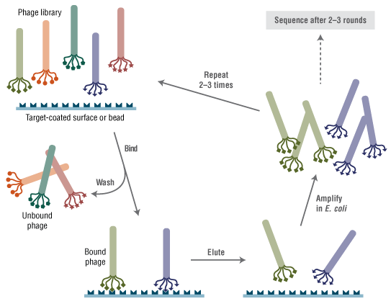
From last meeting: Custom Phage Library
Custom Phage Library with Binder length 7-12:
Let many test peptides compete to see which ones bind best to the target protein
Make billions of tiny test binders
  Genes for peptides inserted into phage coat protein gene of a bacteriophage (virus that infects bacteria)
  Phage will display the peptide on its surface
Attach target protein to plate/surface
Add phage library to plate
  All the phages are poured over the target
  Most don’t bind and are washed away
  A small fraction binds because their peptide happens to match the protein surface
Keep & copy the winners (Each phage contains DNA for its peptide) aka Elution & Amplification
Repeat to improve peptide quality
Read the winning sequences’ DNA inside the final phages, these are the best binding motifs

Slide 8
From in-silico to phage
After obtaining the in-silico peptide sequence
Translate peptide sequence to DNA
Insert DNA for that peptide into phage’s DNA
Phage makes and displays that peptide on its surface
If phage can bind to the target, we know the peptide works

Slide 9
Focus on Binding Motifs instead of a Folded Binder
With a binder length of 7-12 residues, it will be a binding motif that adopts structure only upon binding (intrinsically flexible or disordered on its own)
Stable protein folding requires enough residues to form a hydrophobic core and cooperative secondary structure.
Below roughly 20 to 30 amino acids, peptides lack sufficient contacts to remain folded in solution under physiological conditions.
Most 7 to 12 aa peptides behave like intrinsically disordered peptides when unbound.
https://pmc.ncbi.nlm.nih.gov/articles/PMC11736853
https://www.researchgate.net/publication/372061820_De_Novo_Generation_and_Prioritization_of_Target-Binding_Peptide_Motifs_from_Sequence_Alone
https://en.wikipedia.org/wiki/Short_linear_motif
https://pmc.ncbi.nlm.nih.gov/articles/PMC7545034/

Slide 10
Focus on Binding Motifs instead of a Folded Binder
From Wikipedia (Short linear motif)
Short linear motifs (SLiMs), linear motifs or minimotifs are short stretches of protein sequence that mediate protein–protein interaction.
SLiMs are generally situated in intrinsically disordered regions (over 80% of known SLiMs), however, upon interaction with a structured partner secondary structure is often induced.
The majority of annotated SLiMs consist of 3 to 11 contiguous amino acids, with an average of just over 6 residues.
However, only few hotspot residues (on average 1 hotspot for each 3 residues in the motif) contribute the majority of the free energy of binding and determine most of the affinity and specificity of the interaction.
Although most motifs have no positional preference, several of them are required to be localized at the protein termini in order to be functional.
https://pmc.ncbi.nlm.nih.gov/articles/PMC11736853
https://www.researchgate.net/publication/372061820_De_Novo_Generation_and_Prioritization_of_Target-Binding_Peptide_Motifs_from_Sequence_Alone
https://en.wikipedia.org/wiki/Short_linear_motif
https://pmc.ncbi.nlm.nih.gov/articles/PMC7545034/

Slide 11
Proposal: Switch the loss focus from global structure to interface geometry
De-emphasise:
  Binder internal contact loss
  Radius of gyration
Emphasise:
  Target-binder contact map quality
  Interface residue density
  Binding pose consistency across models
New loss components
  Interface residue count per peptide length
  Fraction of residues within 4-5 Å of target
  Shape complementarity proxy based on distance histograms

Slide 12
Motif-Level Generation
Instead of:
  Mutate/generate whole sequence
Preserve a motif core, randomise flanks
e.g. Implementation:
  Select 2-4 central residues as a binding core
  Keep these residues fixed or softly constrained
  Mutate/hallucinate the remaining positions
Keep Central Residues
Change Other Residues

Slide 13
Optimise for Phage Display: Library Diversity
For short peptides:
  There is no stable fold to constrain the search space
  Binding is dominated by a small number of side chain interactions
  Many sequences can bind weakly, but only a few hit the right geometry and chemistry
Coverage of chemical and geometric space becomes more important than enforcing a specific structure
  i.e. We want to find a library of many different viable motifs, rather than just 1 binder
  Diversity increases the chance of sampling productive side chains

Slide 14
Optimise for Phage Display: Library Diversity
Instead of generating 1 ‘best binder’,
Create a diverse, high-quality library
Add inter-sequence diversity loss:
  Penalise sequence similarity
  Encourage orthogonal motifs

Slide 15
Extra Suggestions

Slide 16
Phage Library-Aware Amino Acid Priors
Real phage libraries are not a uniform 20-AA space.
MutaCraft Enhancement:
Inject phage-realistic amino acid priors directly into the logits.
Examples:
  Reduce Cys to near-zero
  Penalize multiple Trp
  Bias toward Tyr, Phe, Leu, Pro (common in peptide binders)
  Optional enrichment of charged residues for electrostatic steering
This can be done by:
  Logit offsets
  KL-divergence regularisation toward a phage AA distribution
  Making MutaCraft outputs directly synthesisable.

Slide 17
Ensemble Binding Pose Stability Instead of pLDDT
pLDDT is weak for short peptides (measures confidence in a single predicted structure, assuming:
  A dominant folded state
  A well-defined backbone
  Stability in isolation)
MutaCraft Replacement Metric:
Proposal: Consistency across stochastic predictions
Procedure:
  Predict peptide-target complex N times
  Align target
  Measure RMSD of peptide across runs
New metric:
  Low RMSD = stable binding mode
  High RMSD = nonspecific binder
Correlating much better with real phage hits

Slide 18
Motif-Seeded Logit Initialisation
MutaCraft Initialisation Strategy
Instead of random logits:
  Convert an input peptide into a soft logit matrix
  Blend with random noise
Initial logits = α * motif_logits + (1 − α) * random_logits
Where:
  α ∈ [0.3, 0.7]
  motif_logits encode known binder preferences
Allowing:
  Controlled drift from known binders
  Escape from local minima
  Exploration without losing signal

Slide 19
Length-Aware Mutation Budget
For 7-12 aa, mutating x percent of length makes less sense
Proposal: Mutation count per step:
  Always 1-2 residues
  Bias toward flanking residues first
  Only mutate core if loss plateaus
Mimicking experimental affinity maturation

Slide 20
Experimental Readout-Aware Scoring
Since we are actually screening the binders,
Optimise for:
  Single-point mutations robustness
  Reduced aggregation risk
  Minimal hydrophobic clustering
  No protease cleavage motifs

Slide 21
Summary
Hybrid mutational + de novo peptide design framework
Explicitly optimised for experimental phage display
Bridging AlphaFold-guided geometry with library-scale constraints
More efficient search than pure random libraries

